Slide 1

DEEP LEARNING IMAGE CLASSIFIER FOR EMOTION DETECTION(HAPPY OR SAD) USING CNN
Presented by-ARIT KAR
Intern id-MST03-0071
Guided by-urooj khan

Slide 2
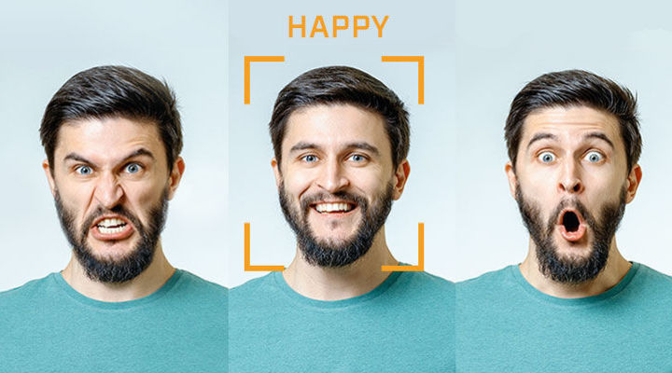
WHAT IS EMOTION DETECTION:
Emotion detection, also known as emotion recognition, is the process of identifying and interpreting human emotions from various sources of data, such as facial expressions, voice tones, physiological signals, and text.
Used in various applications like mental health monitoring, customer feedback analysis, and emotionally aware robots.

Slide 3

WHAT ARE CONVOLUTION NEURAL NETWORK?
Inspired by the human brain
Made up of interconnected nodes (neurons)
Learn patterns from data
Can solve complex image problems

Slide 4
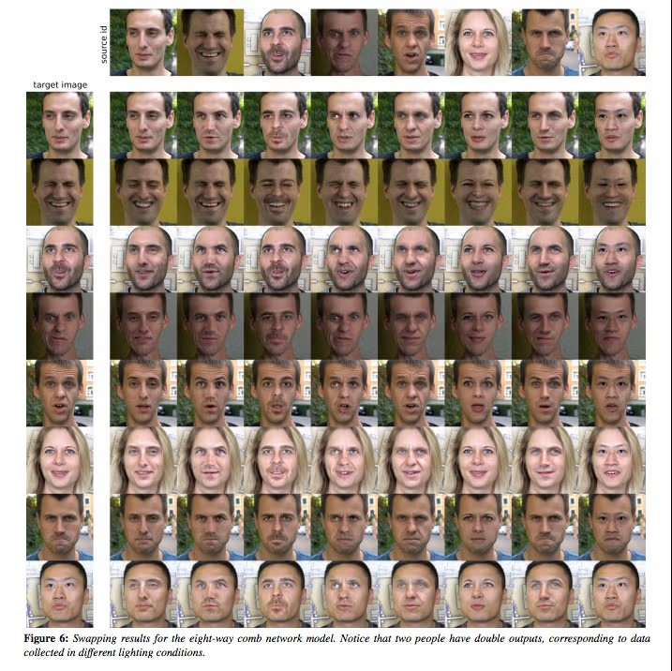
DATA COLLECTION?
Collect the data from google.
Load the data into our environment by using keras.utils from our directory.
Each image is of dimension (256,256,3).

Slide 5
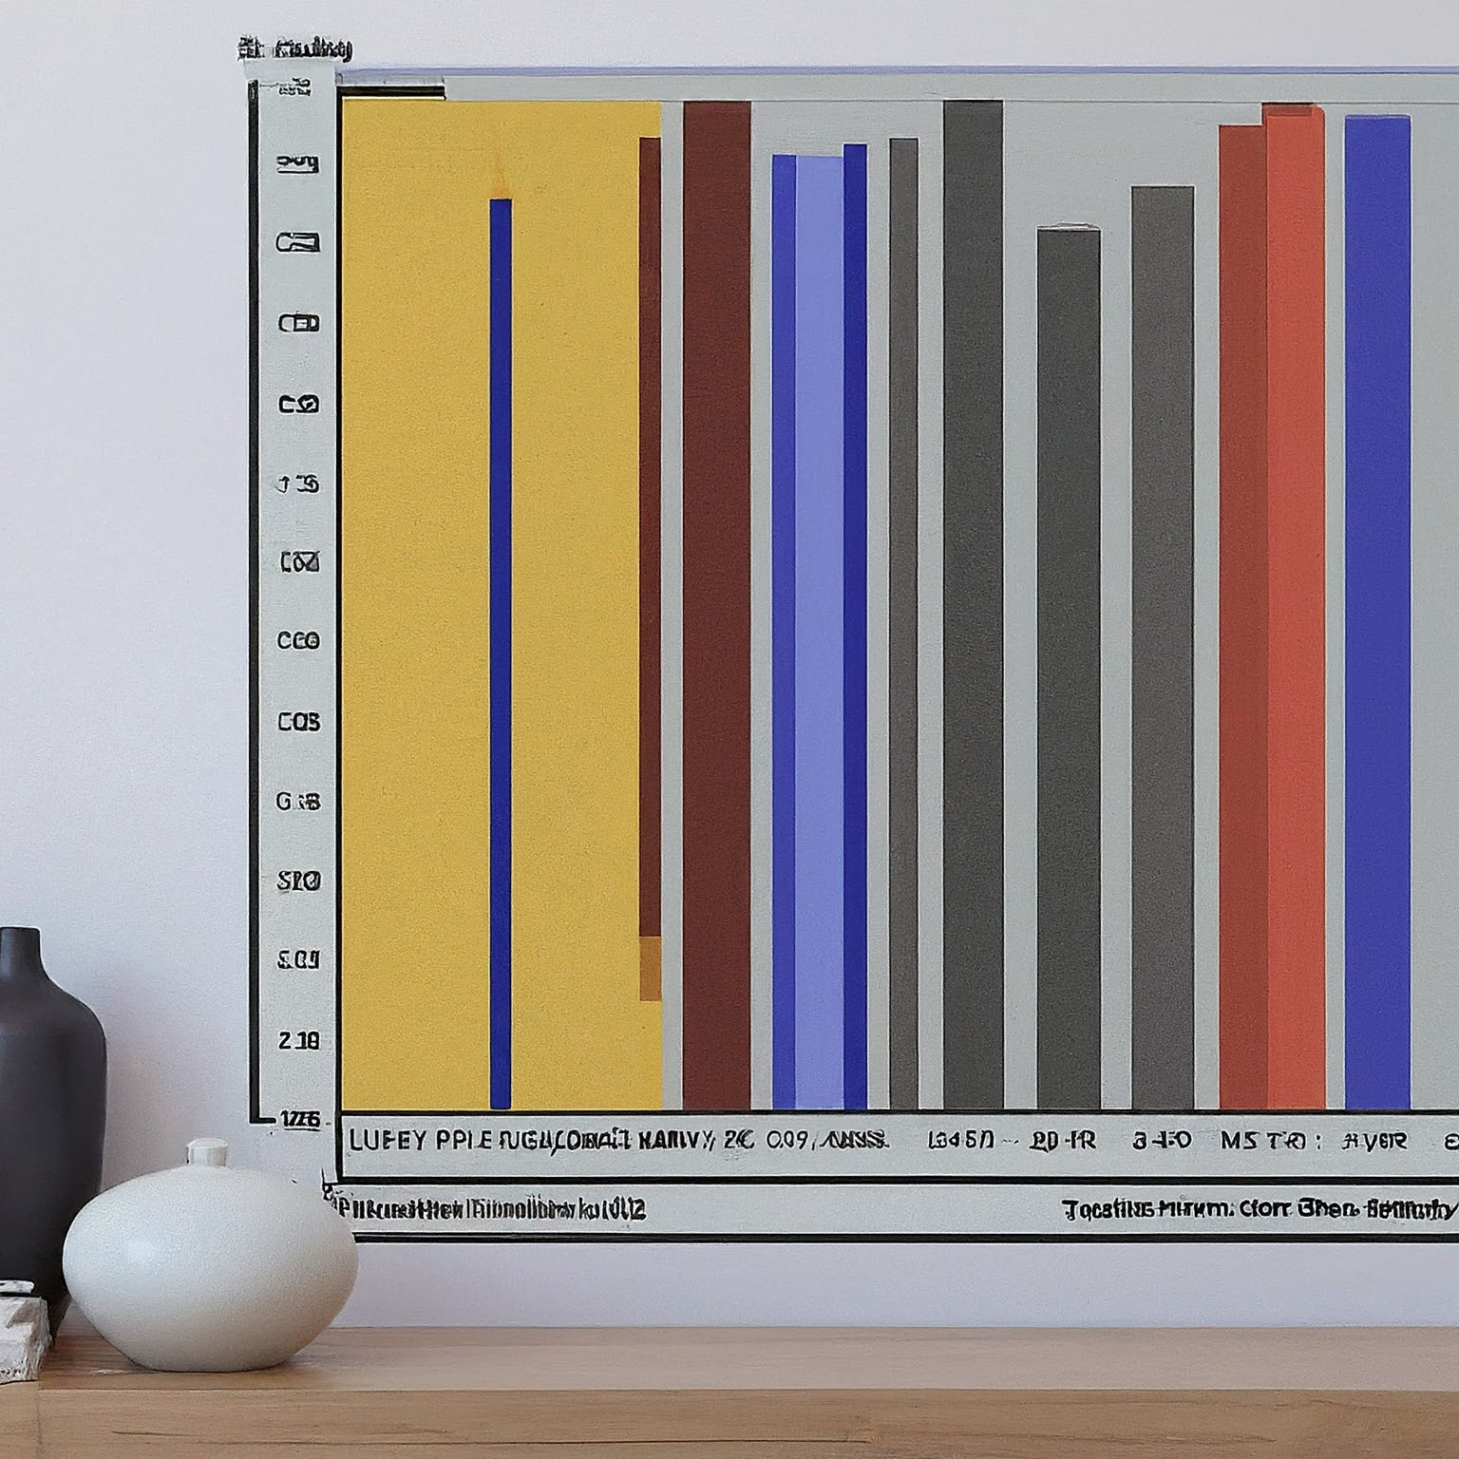
PREPARATION OF DATA-NORMALIZATION MAGIC :
Transforming pixel values from their original range of 0-255 to a normalized range of 0-1.
This ensures all values fall within a similar range, enhancing the training process for our neural network.

Slide 6
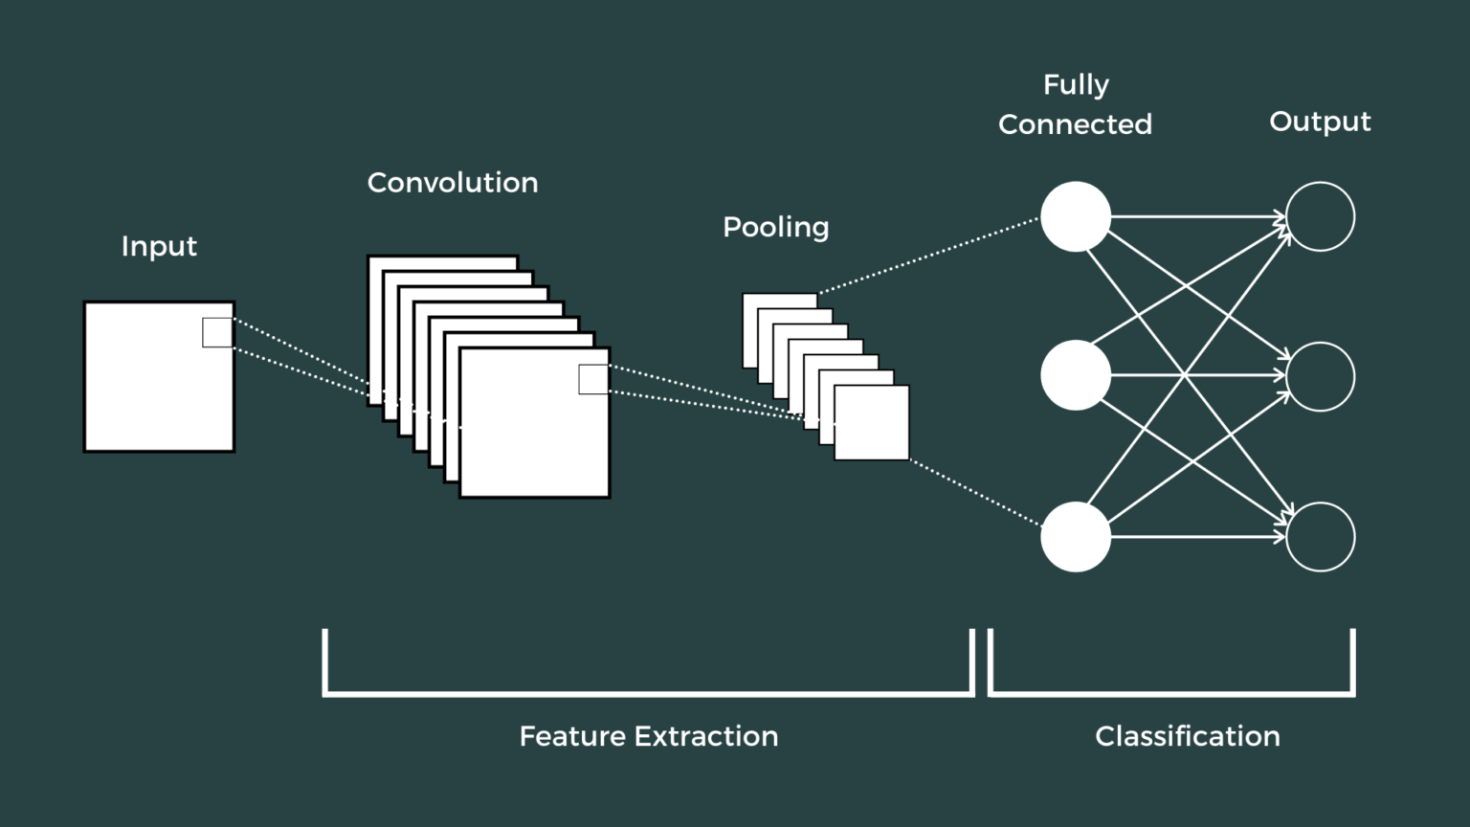
BUILD THE CNN:
Preprocess the dataset (normalize, flatten)
Define the CNN architecture (input, hidden, output layers)
Choose an activation function (e.g., ReLU)
Define a loss function (e.g., categorical cross-entropy)
Train the ANN using an optimizer (e.g., Adam)
Evaluate the model's performance on the test set

Slide 7
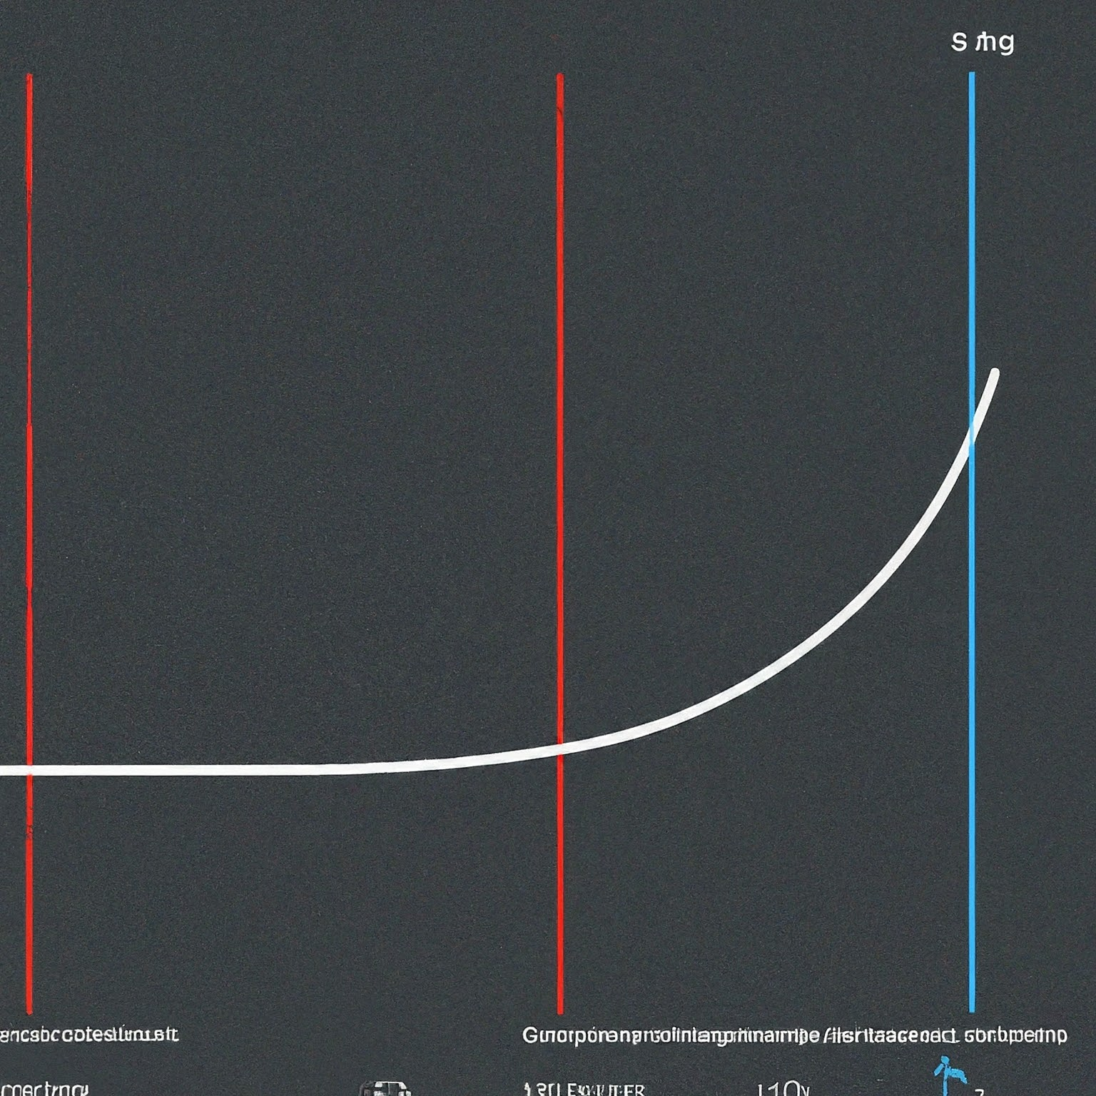
TRANING THE MODEL :
Data Split: To prevent overfitting (memorizing training data without generalizing well), we split the training data into three parts:
Epochs: Each epoch represents one complete pass through the entire training set. We train the model for multiple epochs (20 in this case) to allow it to learn effectively.
Loss Function: We use “binary crossentropy" as the loss function, measuring the difference between the model's predictions and the true labels.
Optimizer: The "Adam" optimizer helps adjust the model's parameters based on the calculated loss, guiding it towards better performance.

Slide 8

REFINING THE MODEL-MONITORING PROGRESS AND EVALUATION :
Training and Validation Curves: We plot the training and validation loss/accuracy curves to track the model's progress.
Training Curves: Ideally, they should decrease steadily, indicating the model is learning the patterns in the data.
Validation Curves: They should also decrease, but may fluctuate slightly, as they represent performance on unseen data.
Accuracy: We calculate the accuracy on the test set after training to assess the model's generalization ability on completely new data.

Slide 9
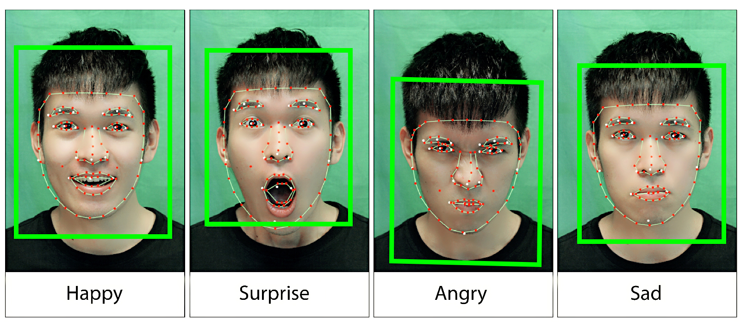
UNVEILING THE RESULT-PREDICTION :
Making Predictions: We use the trained model to predict the emotion(happy or sad) in the test image.
We feed each image into the model, and it outputs a value between 0 and 1.
If the values is less than 0.5 then it is a happy emotion else it ia a sad emotion.

Slide 10
CONCLUSION :
CNNs have achieved high accuracy in facial expression recognition, exceeding human performance.
Continuous research explores deeper and more complex architectures, for even better results.
Applications extend beyond including object recognition, medical image analysis.

Slide 11
THANK YOU

